Slide 1
Authentication
Lecture 3

Slide 2
Security tools: authentication, access control and cryptography
A security professional analyzes situations by finding threats and vulnerabilities to the confidentiality, integrity, and/or availability of a computing systems.
Often, controlling these threats and vulnerabilities involves a policy that specifies who (which subjects) can access what (which objects) how (by which means).
The property of accurate identification is called authentication.

Slide 3
Identification vs. Authentication
Identification is the act of asserting who the person is.
Authentication is the act of proving that asserted identity: that the person is who he says he is.
The two concepts of identification and authentication are easily and often confused. Identities, like names, are often well known, public and not protected. On the other hand, authentication is necessary protected. If someone’s identity is public, anyone can claim to be that person. What separates the pretenders from the real person is proof by authentication.

Slide 4
Authentication mechanisms
Authentication mechanisms use any of three qualities to confirm a user’s identity:
Something the user knows. Passwords, PIN numbers, passphrases, a secret handshake, and mother’s maiden name are examples of what a user may know.
Something the user is. These authenticators, called biometrics, are based on a physical characteristics of the user, such as a fingerprint, the pattern of a person’s voice, or a face (picture).
Something the user has. Identity badges, physical keys, a driver’s license are examples of things people have that make them recognizable.

Slide 5
Passwords
Security questions
Password use
Use. Supplying a password for each access to an object can be inconvenient and time-consuming.
Disclosure. If a user discloses a password to an unauthorized individual, the object becomes immediately accessible.
Revocation. To revoke one user’s access right to an object, someone must change the password, thereby causing the same problems as disclosure.
Loss. Depending on how the passwords are implemented, it may be impossible to retrieve a lost or forgotten password.

Slide 6
Attacking and Protecting Passwords
The password guessing steps:
no password
the same as the user ID
is, or is derived from, the user’s name
on a common word list (e.g., password, secret, private) plus common names and patterns (e.g., qwerty, aaaaaa)
contained in a short college dictionary
contained in a complete English word list
contained in a short college dictionary with capitalizations (PaSsWorD) or substitutions (digit 0 for letter O, and so forth)
Every password can be guessed; password strength is determined by how many guesses are required.

Slide 7
Dictionary Attacks
Several network sites post dictionaries of phrases, science fiction characters , names, places, mythological names, Chinese words, Yiddish words, and other specialized lists. These list help site administrators identify users who have chosen week passwords, but the same dictionaries can also be used by attackers of sites that do not have such attentive administrators.

Slide 8
Inferring Passwords likely for a user
Do we choose passwords at random?
How long would it take for a computer to guess a personal password?

Slide 9
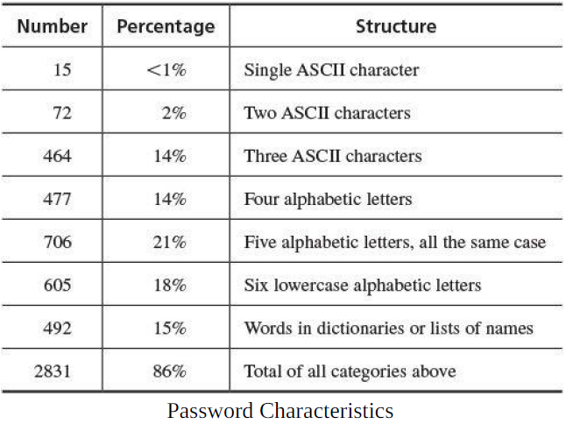
Password characteristics and types

Slide 10
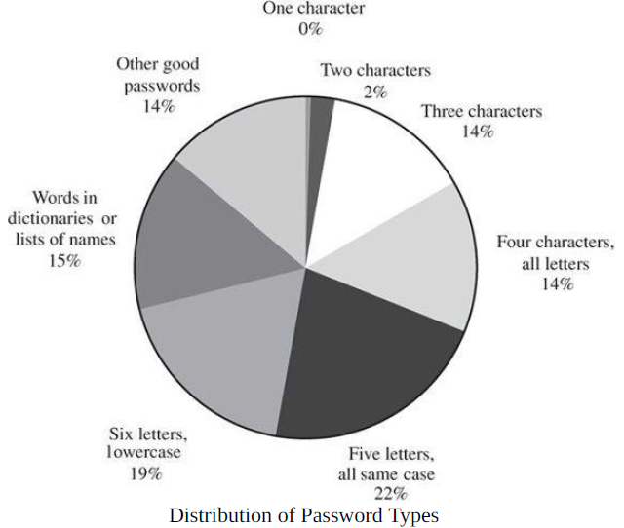
Password characteristics and types

Slide 11
Guessing Possible Passwords
Think of a word.
Is the word you thought is long?
Is it uncommon?
Is it hard to spell or to pronounce?

Slide 12
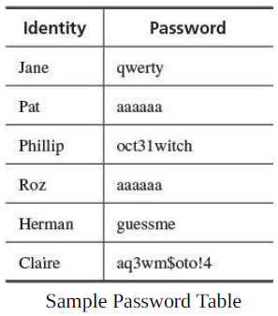
Defeating Concealment
Easier than guessing a password is just to read one from table:

Slide 13
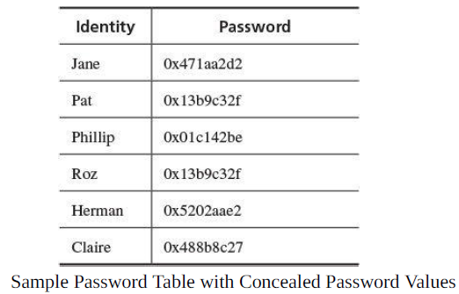
Defeating Concealment
Operating systems store passwords in hidden (encrypted) form so that compromising the id-password list does not give immediate access to all user accounts.

Slide 14
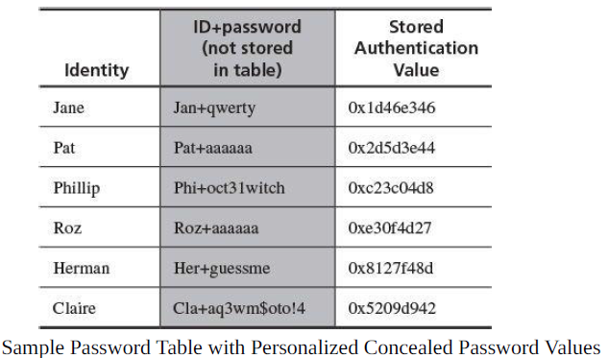
Defeating Concealment

Slide 15
Good Passwords
If you do use passwords, we can improve their security by a few simple practices:
Use characters other than just a-z.
Choose long passwords.
Avoid actual names or words.
Use a string you can remember (UcnB2s), but don’t be too obvious (I10v3U is already in the search file).

Slide 16
Good Passwords
Use variants for multiple passwords (e.g., Ih1b2s – I have 2 brothers 1 sister – and append the other pattern: Ih1b2sIvs – for Visa).
Change the passwords regularly.
Don’t write it down.
Don’t tell anyone else.

